Slide 1
Chapter 4 Combinational Logic
Digital Electronics

Slide 2
Outline of Chapter 4
4.1 Introduction
4.2 Design Procedure
4.3 Hazards
4.4 Adders
4.5 Subtractors
4.6 Code Conversion
4.7 Analysis Procedure
4.8 Multilevel NAND Circuits
4.9 Multilevel NOR Circuits
4.10 Exclusive OR & Equivalent Functions

Slide 3
INTRODUCTION
A combinational circuit consists of logic gates whose outputs, at any time, are determined by combining the values of the inputs.
For n input variables, there are 2^{n} possible binary input combinations.
For each binary combination of the input variables, there is one possible output.

Slide 4
INTRODUCTION
Hence, a combinational circuit can be described by:
A truth table that lists the output values for each combination of the input variables, or
m Boolean functions, one for each output variable.
Combinational
Circuit
n-inputs
•
m-outputs
•
•
•
•
•

Slide 5
INTRODUCTION
n-inputs
Combinational
Circuit
m-outputs
(Depend only on inputs)
Combinational Circuit
n-inputs
m-outputs
Combinational
Circuit
Storage
Elements
Next
state
Present
state
Sequential Circuit

Slide 6
DESIGN PROCEDURE
The procedure involves the following steps:
State the problem.
Determine no. of available input variables and required output variables.
Assign letter symbols to the input and output variables.
Derive the truth table that defines the required relationship between inputs and outputs.
Obtain simplified Boolean function for each output.
Draw the logic diagram.

Slide 7
HAZARDS
A hazard, if exists, in a digital circuit causes a temporary fluctuation in output of the circuit.
In other words, a hazard in a digital circuit is a temporary disturbance in ideal operation of the circuit which if given some time, gets resolved itself.
These disturbances or fluctuations occur when different paths from the input to output have different delays and due to this fact, changes in input variables do not change the output instantly but do appear at output after a small delay caused by the circuit building elements, i.e., logic gates.

Slide 8
HAZARDS
There are three different kinds of hazards found in digital circuits
Static hazard
A static hazard takes place when change in an input causes the output to change momentarily before stabilizing to its correct value.
2. Dynamic hazard
A dynamic hazard is the possibility of an output changing more than once as a result of a single input change.
3. Functional/Hybrid hazard
Functional hazards are non-solvable hazards which occurs when more than one input variable changes at the same time.

Slide 9
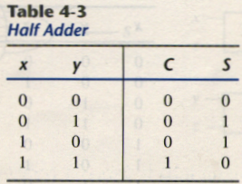
ADDERS(HALF ADDER)
A combinational circuit that performs the addition of two bits is called a half adder.
The truth table for the half adder is listed below:
S = x’y + xy’
C = xy
S: Sum
C: Carry

Slide 10
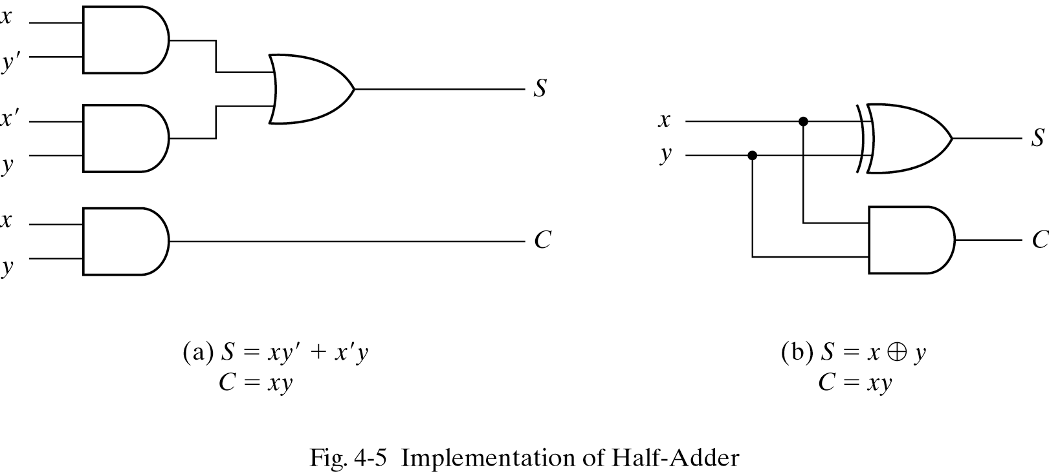
ADDERS(HALF ADDER)
Implementation of HALF ADDER

Slide 11
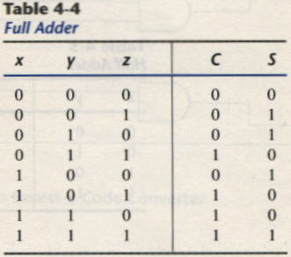
ADDERS (FULL ADDER)
One that performs the addition of three bits(two significant bits and a previous carry) is a full adder.
11

Slide 12
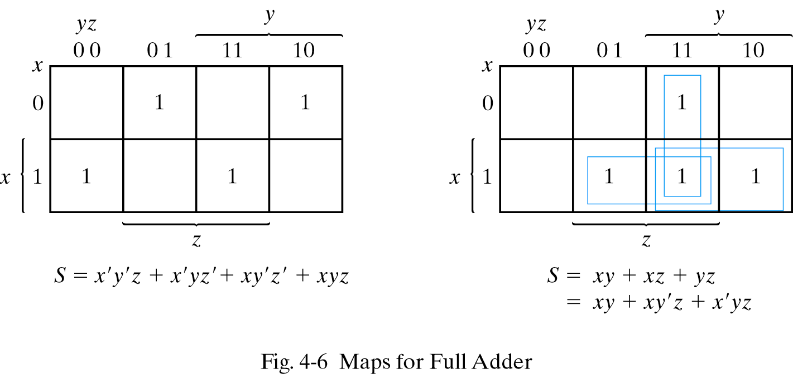
ADDERS (FULL ADDER)
Simplified Expression
C
S = x’y’z + x’yz’ + xy’z’ + xyz
C = xy + xz + yz

Slide 13
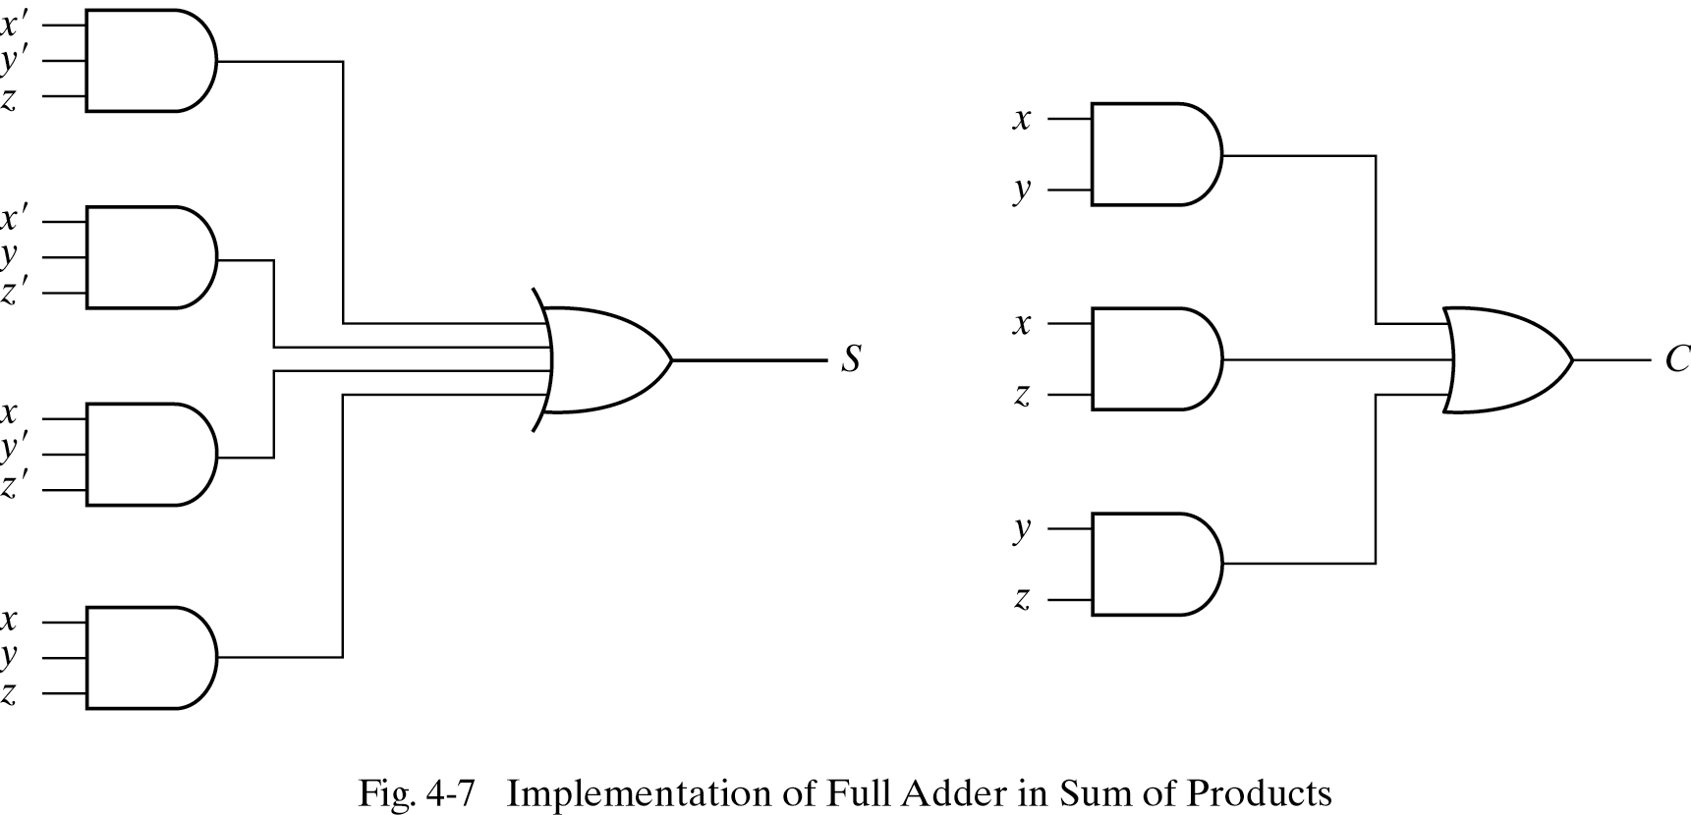
ADDERS (FULL ADDER)
Full Adder Implementation in SOP

Slide 14
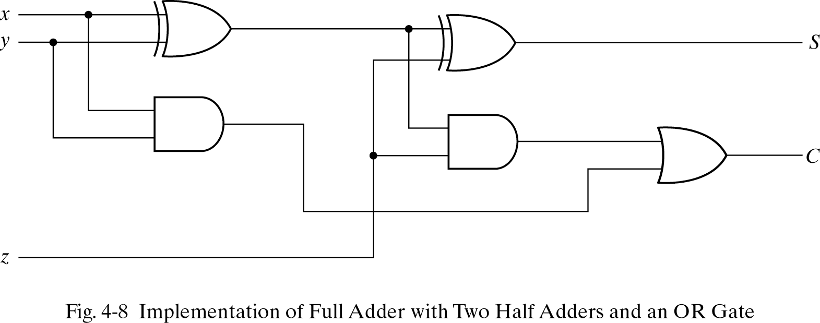
ADDERS (FULL ADDER)
Full-adder can also implemented with two half adders and one OR gate (Carry Look-Ahead adder).
S = z ⊕ (x ⊕ y)
= z’(xy’ + x’y) + z(xy’ + x’y)’
= xy’z’ + x’yz’ + xyz + x’y’z
C = z(xy’ + x’y) + xy = xy’z + x’yz + xy

Slide 15
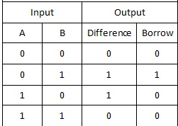
SUBTRACTORS(HALF SUBTRACTOR)
A combinational circuit that performs the subtraction of two bits is called a half subtractor.
The truth table for the half subtractor is listed below:
Difference = A’B+AB’
Borrow = A’B

Slide 16
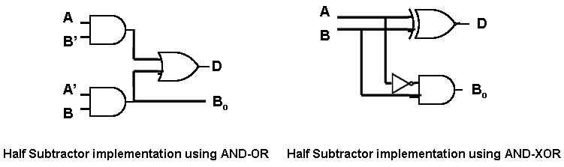
SUBTRACTORS(HALF SUBTRACTOR)
Implementation of HALF SUBTRACTOR
(a)
D = A’B+AB’
B = A’B
(b)
D = A’B+AB’
B = A’B

Slide 17
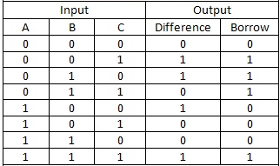
SUBTRACTORS(FULL SUBTRACTOR)
One that performs the subtraction of three bits is a full subtractor.
Truth table of full subtractor

Slide 18
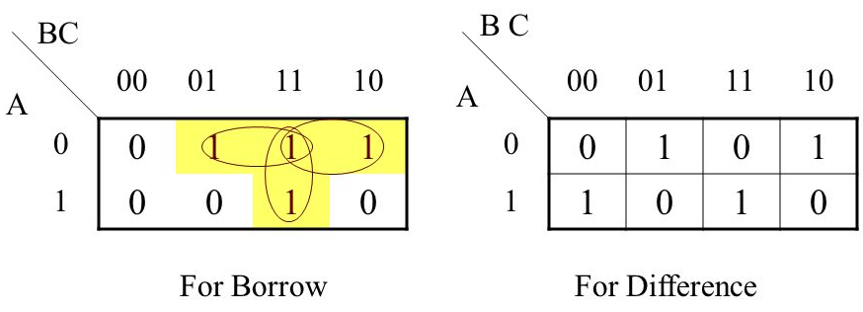
SUBTRACTORS(FULL SUBTRACTOR)
Simplified Expression
D = A’B’C+A’BC’+AB’C’+ABC
C = A’C+A’B+BC

Slide 19
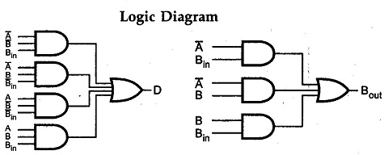
SUBTRACTORS(FULL SUBTRACTOR)
Full Subtractor Implementation in SOP

Slide 20
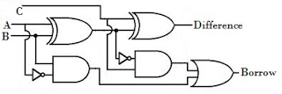
SUBTRACTORS(FULL SUBTRACTOR)
Logic diagram of Full Subtractor has been shown in the figure below:

Slide 21
CODE CONVERSION
Code conversion is a process that converts data from one type of binary code to another type of binary code.
A code converter is a logic circuit that changes data presented in one type of binary code to another type of binary code, such as BCD to binary, BCD to 7−segment, binary to BCD, BCD to XS3, binary to Gray code, and Gray code to binary.

Slide 22
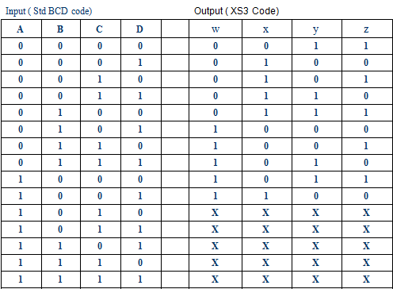
CODE CONVERSION
BCD to XS-3 Code Conversion

Slide 23
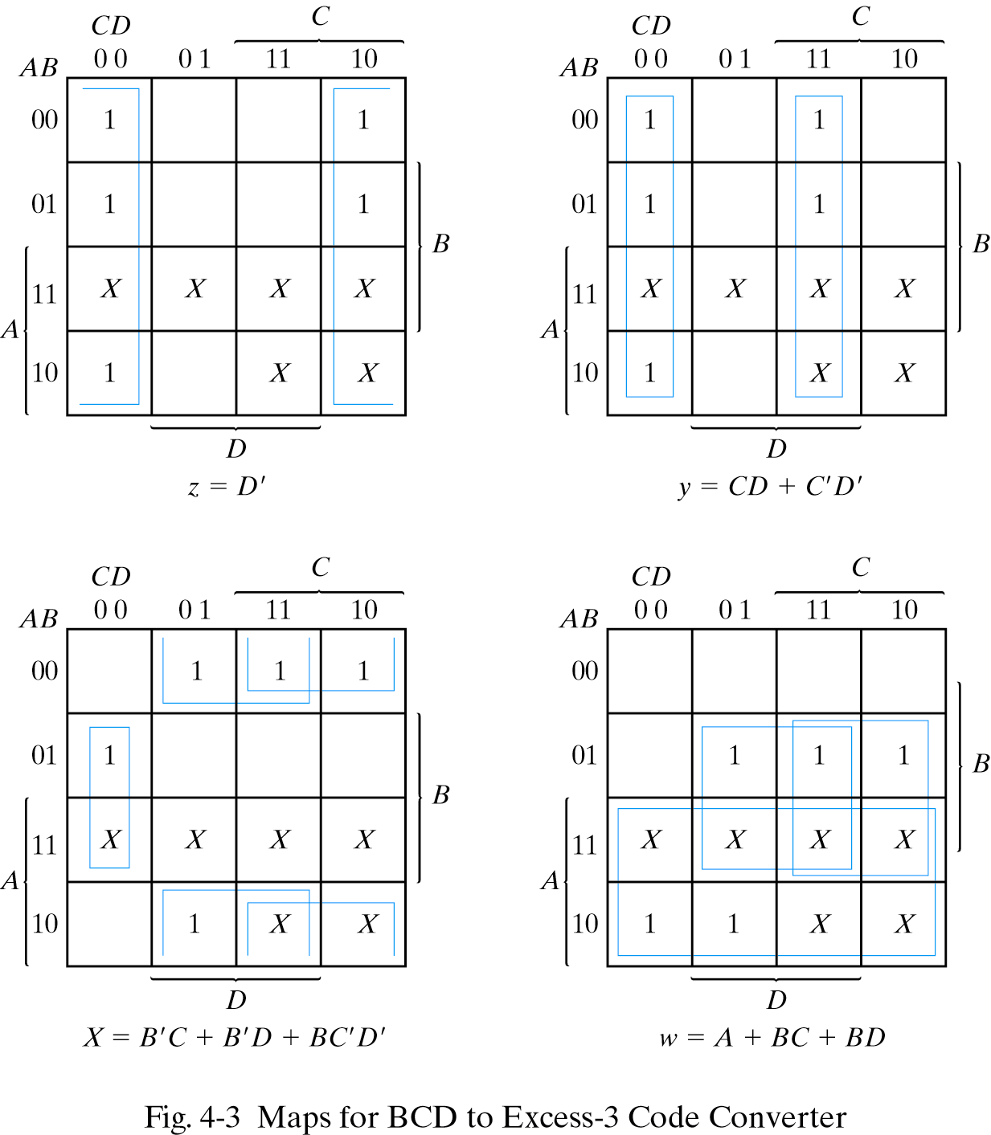
CODE CONVERSION
K- Maps for Simplification and Simplified Boolean Functions

Slide 24
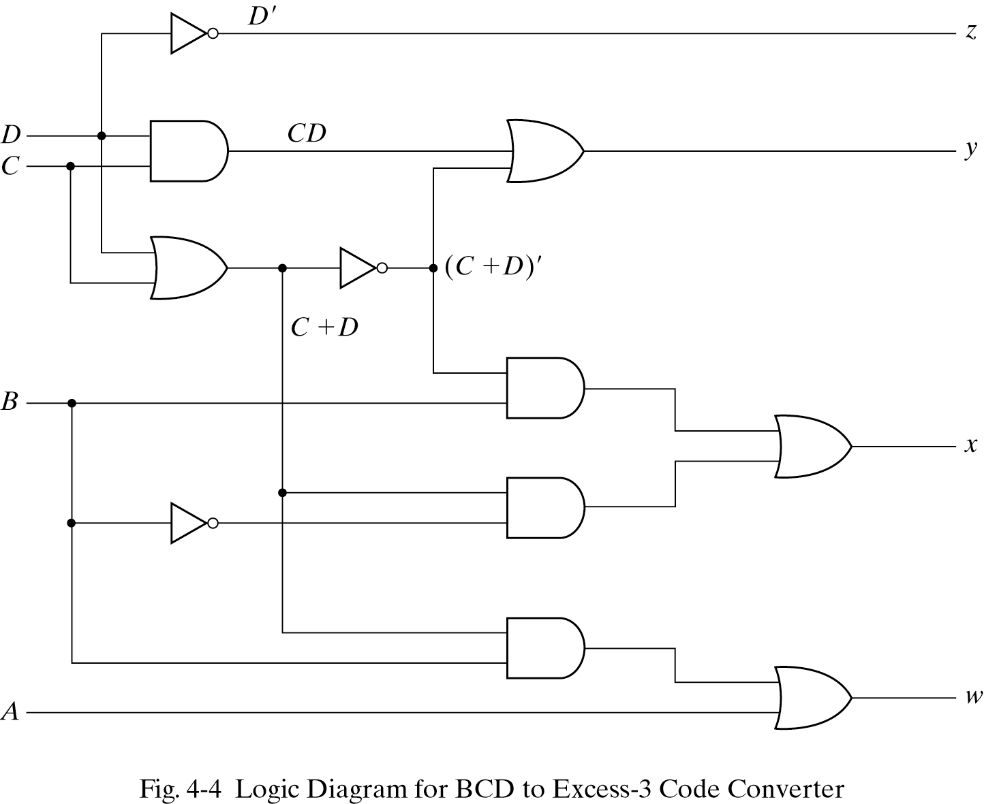
CODE CONVERSION

Slide 25
ANALYSIS PROCEDURE
Analysis:
determine the function that the circuit implements.
Often start with a given logic diagram.
The analysis can be performed by:
1. Manually finding Boolean functions
2. Manually finding truth table
3. Using a computer simulation program
First step:
Make sure that circuit is combinational
Without feedback paths or memory elements
Second step:
Obtain the output Boolean functions or the truth table

Slide 26
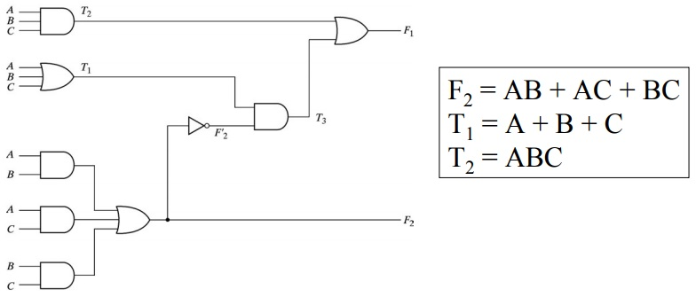
ANALYSIS PROCEDURE(CONTD.)
Step 1:
Label all gate outputs that are a function of input variables
Determine Boolean functions for each gate output
Figure 4.1

Slide 27
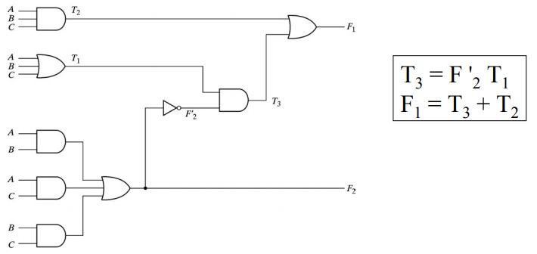
ANALYSIS PROCEDURE(CONTD.)
Step 2:
Label the gates that are a function of input variables and previously labeled gates
Find the Boolean function for these gates

Slide 28
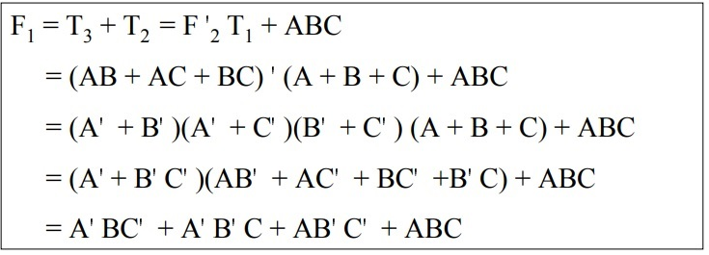
ANALYSIS PROCEDURE(CONTD.)
Step 3:
Obtain the output Boolean function in term of input variables
By repeated substitution of previously defined functions

Slide 29
ANALYSIS PROCEDURE(CONTD.)
To obtain the truth table from the logic diagram:
1. Determine the number of input variables For n inputs:
2^{n} possible combinations
List the binary numbers from 0 to 2^{n}-1 in a table
2. Label the outputs of selected gates
3. Obtain the truth table for the outputs of those gates that are a function of the input variables only
4. Obtain the truth table for those gates that are a function of previously defined variables at step 3
Repeatedly until all outputs are determined

Slide 30
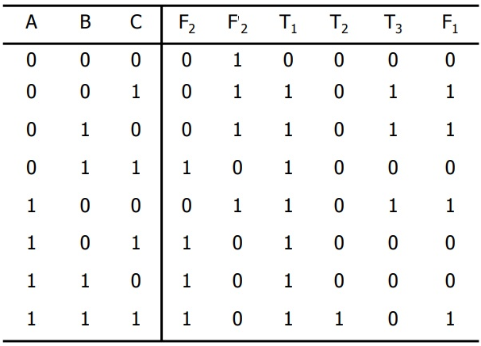
ANALYSIS PROCEDURE(CONTD.)
Truth Table for Figure 4.1:

Slide 31
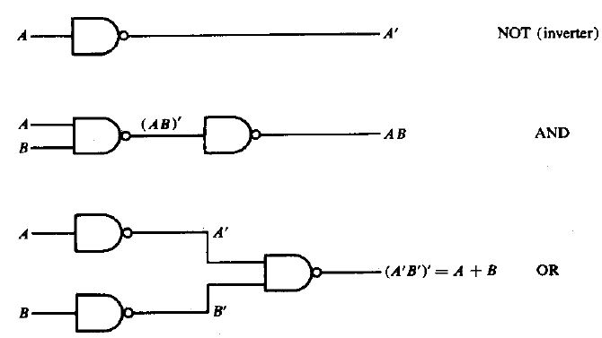
MULTI LEVEL NAND AND NOR CIRCUITS
The NAND gate is said to be a universal gate because any digital system can be implemented with it.
The implementation of the AND,OR and NOT operations with NAND gate is shown in Fig. below.

Slide 32
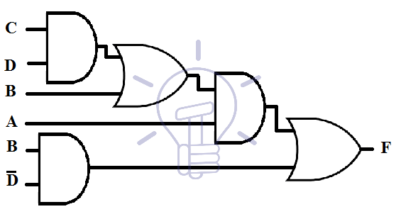
MULTI LEVEL NAND AND NOR CIRCUITS
Suppose a multi-level function be;
F = A ( B + CD ) + BD’
AND-OR Schematic

Slide 33
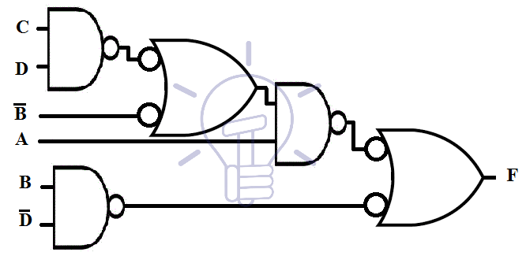
MULTI LEVEL NAND AND NOR CIRCUITS
Suppose a multi-level function be;
F = A ( B + CD ) + BD’
AND-INVERT and INVERT-OR Schematic

Slide 34
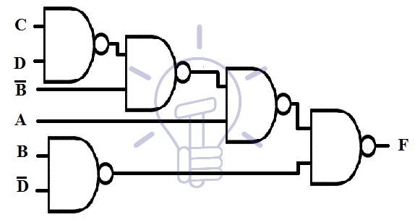
MULTI LEVEL NAND AND NOR CIRCUITS
Suppose a multi-level function be;
F = A ( B + CD ) + BD’
NAND Schematic

Slide 35
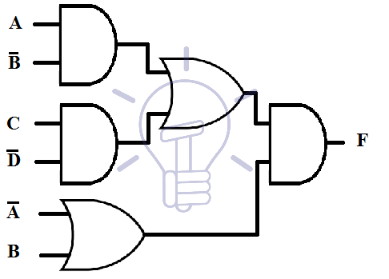
MULTI LEVEL NAND AND NOR CIRCUITS
Suppose 3-level function be
F = ( AB’+CD’ ) ( A’+B )
AND-OR Schematic

Slide 36
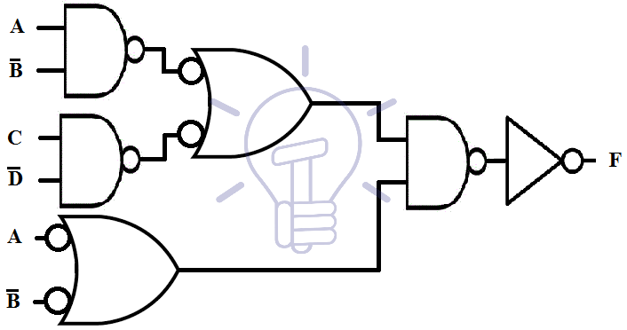
MULTI LEVEL NAND AND NOR CIRCUITS
Suppose 3-level function be
F = ( AB’+CD’ ) ( A’+B )
AND-INVERT and INVERT-OR Schematic

Slide 37
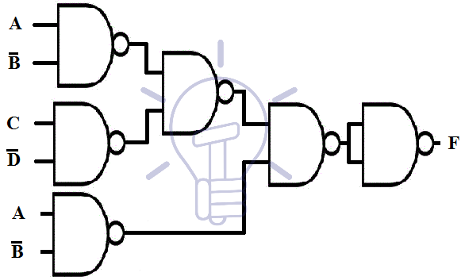
MULTI LEVEL NAND AND NOR CIRCUITS
Suppose a multi-level function be;
F = ( AB’+CD’ ) ( A’+B )
NAND Schematic

Slide 38
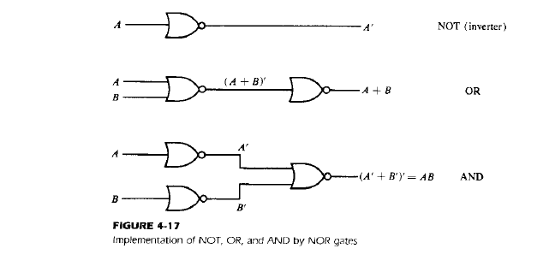
MULTI LEVEL NAND AND NOR CIRCUITS
The NOR gate is said to be a universal gate because any digital system can be implemented with it.
The implementation of the AND,OR and NOT operations with NOR gate is shown in Fig. below.

Slide 39
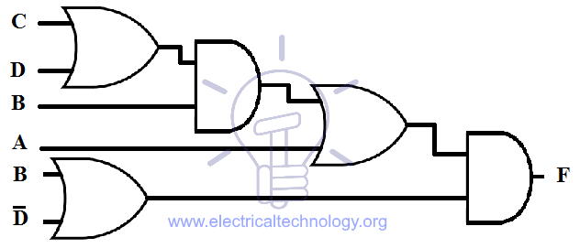
MULTI LEVEL NAND AND NOR CIRCUITS
Suppose a 4-level function:
F = ( A + B ( C + D )) ( B + D’ )
AND-OR Schematic

Slide 40
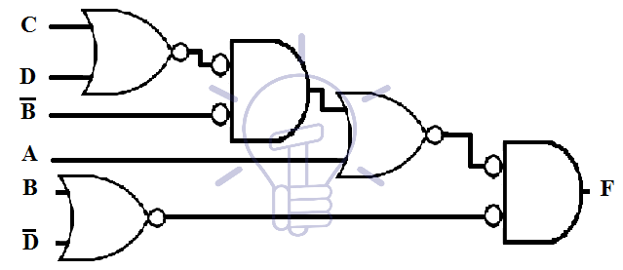
MULTI LEVEL NAND AND NOR CIRCUITS
Suppose a 4-level function:
F = ( A + B ( C + D )) ( B + D’ )
OR Invert and Invert AND Schematic

Slide 41
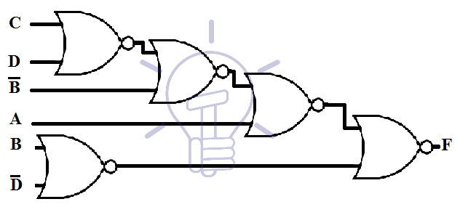
MULTI LEVEL NAND AND NOR CIRCUITS
Suppose a 4-level function:
F = ( A + B ( C + D )) ( B + D’ )
OR Invert and Invert AND Schematic

Slide 42
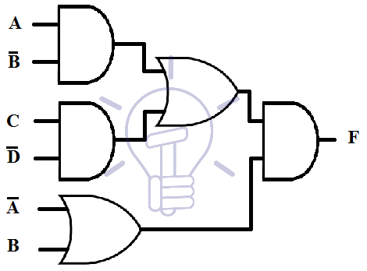
MULTI LEVEL NAND AND NOR CIRCUITS
Suppose a 4-level function:
F = ( AB’ + CD’ ) ( A’ + B )
AND-OR Schematic

Slide 43
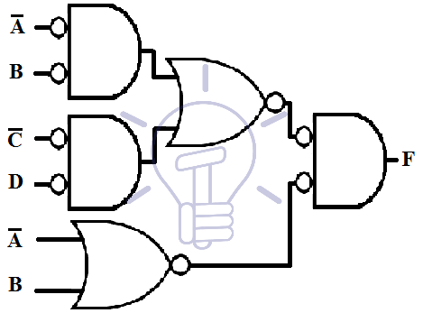
MULTI LEVEL NAND AND NOR CIRCUITS
Suppose a 4-level function:
F = ( AB’ + CD’ ) ( A’ + B )
OR Invert and Invert AND Schematic

Slide 44
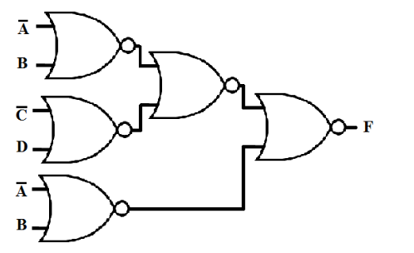
MULTI LEVEL NAND AND NOR CIRCUITS
Suppose a 4-level function:
F = ( AB’ + CD’ ) ( A’ + B )
OR Invert and Invert AND Schematic

Slide 45
Ex-OR and Equivalence Functions
Exclusive-OR and equivalence, denoted by ⊕ and ʘ, respectively, are binary operations that perform the following Boolean functions:
x⊕y = x’y+xy’
x ʘ y = x’y’+xy
The two operations are complement of each other. Each is commutative and associative.

